Slide 1
Lecture 12 Machine Learning
Dr. Johnny Cheng

Slide 2
Lessons Intended Learning Outcomes
On completion of this lesson, students are expected to be able to:
Identify a machine learning problem.
Describe the categories of machine learning approaches.
Identify the functionality of the scikit-learn Library.
Use scikit-learn to implement supervised learning, unsupervised learning and text analysis.

Slide 3
Machine Learning
Machine Learning with scikit-learn
Supervised Learning
Unsupervised Learning
Working with Text Data

Slide 4
Machine Learning with scikit-learn
We use machine learning to refer to creating and using models that are learned from data.
A model is simply a specification of a mathematical (or probabilistic) relationship that exists between different variables.
For instance, a cookbook recipe entails a model that relates inputs like “number of eaters” and “hungriness” to quantities of ingredients needed.
A business model may be a simple mathematical relationship:
profit = revenue (units sold × average price) − expenses

Slide 5
Machine Learning with scikit-learn (cont.)
Machine learning is a technique with a growing importance, as the size of the datasets that experimental sciences are facing is rapidly growing.
Problems it tackle range from building a prediction function linking different observations, to classifying observations, or learning the structure in a unlabeled dataset.
We will emphasize statistical learning, the use of machine learning techniques with the goal of statistical inference, i.e., drawing conclusion on the data at hand.

Slide 6
Machine Learning with scikit-learn (cont.)
In general, a learning problem considers a set of n samples of data and then tries to predict properties of unknown data.
If each sample is more than a single number and, for instance, a multi-dimensional entry (or multivariate data), it is said to have several attribute or features.
We may divide learning problems into two main categories:
Supervised learning, in which the data comes with additional attributes that we want to predict. An example would be the determination of spam,
Unsupervised learning, in which the training data consists of a set of input vectors without any corresponding target values. For example, recommendation of products to customers based on past purchases.

Slide 7
Machine Learning with scikit-learn (cont.)
Machine Learning
Supervised Learning
Classification
Regression
Unsupervised Learning
Clustering

Slide 8
Machine Learning with scikit-learn (cont.)
scikit-learn is a Python module integrating classic machine learning algorithms in the tightly-knit world of scientific Python packages (numpy, scipy, matplotlib).
scikit-learn comes with a few standard datasets, including the iris(鳶尾花) and digits datasets for classification and the Housing Data Set for regression.
Here we load the iris and digits datasets:
>>> from sklearn import datasets
>>> iris = datasets.load_iris()
>>> digits = datasets.load_digits()

Slide 9
Supervised Learning
Datasets and Estimators
Classification and Regression
Classification with Nearest Neighbors
Regression with Linear Model

Slide 10
Datasets and Estimators
scikit-learn deals with learning information from one or more datasets that are represented as 2D arrays.
They can be understood as a list of multi-dimensional observations.
The first axis of these arrays is called the samples axis, while the second is the features axis.
Here is a simple example shipped with scikit: iris dataset.
>>> from sklearn import datasets
>>> iris = datasets.load_iris()
>>> data = iris.data
>>> data.shape
(150, 4)

Slide 11
Datasets and Estimators (cont.)
iris dataset is made of 150 observations of irises, each described by 4 features: their sepal (花萼) length, sepal width, petal (花瓣) length, and petal width.
When the data is not initially in the (n_samples, n_features) shape, it needs to be preprocessed in order to be used by scikit-learn.
The digits dataset is made of 1797 8×8 images of hand-written digits:
>>> digits = datasets.load_digits()
>>> digits.images.shape
(1797, 8, 8)
>>> import pylab as pl
>>> pl.imshow(digits.images[-1], cmap=pl.cm.gray_r)
<matplotlib.image.AxesImage object at 0x08795A90>

Slide 12
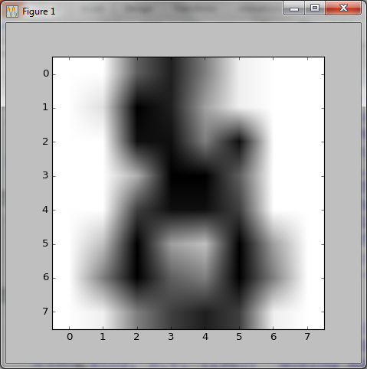
Datasets and Estimators (cont.)
>>> plt.show()
To use this dataset with scikit, we transform each 8×8 image into a feature vector of length 64:
>>> data = digits.images.reshape ((digits.images.shape[0], -1))
Estimator objects
The main API implemented by scikit-learn is that of the estimator.
An estimator is any object that learns from data.

Slide 13
Datasets and Estimators (cont.)
An estimator may be a classification, regression or clustering algorithm or a transformer that extracts/filters useful features from raw data.
All estimator objects expose a fit method that takes a dataset (usually a 2D array):
>>> estimator.fit(data)
All the parameters of an estimator can be set when it is instantiated or by modifying the corresponding attribute:
>>> estimator = Estimator(param1=1, param2=2)
>>> estimator.param1

Slide 14
Classification and Regression
Supervised learning consists in learning the link between two datasets:
the observed data X, and
an external variable y that we are trying to predict, usually called “target” or “label”.
Most often, y is a 1D array of length n_samples.
All supervised estimators in scikit-learn implement :
a fit(X, y) method to fit the model, and
a predict(X) method that, given unlabeled observations X, returns the predicted labels y.

Slide 15
Classification and Regression (cont.)
If the prediction task is to classify the observations in a set of finite labels (discrete), in other words to “name” the objects observed, the task is said to be a classification task.
If the goal is to predict a continuous target variable, it is said to be a regression task.
When doing classification in scikit-learn, y is a vector of integers or strings.

Slide 16
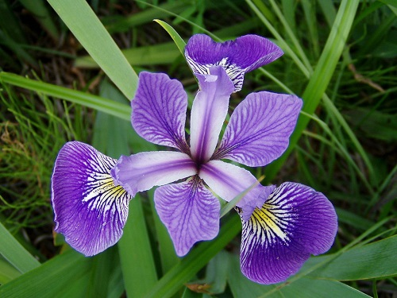
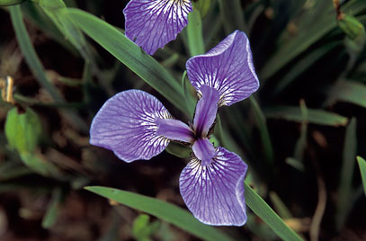

Classification with Nearest Neighbors
The iris dataset is a classification task consisting in identifying 3 different types of irises (Setosa (山鳶尾), Versicolour (變色鳶尾), and Virginica (維吉尼亞鳶尾)) from their petal and sepal length and width.
Versicolour
Setosa
Virginica

Slide 17
Classification with Nearest Neighbors (cont.)
Let’s load the iris dataset first:
>>> import numpy as np
>>> from sklearn import datasets
>>> iris = datasets.load_iris()
>>> iris_X = iris.data
>>> iris_y = iris.target
>>> np.unique(iris_y)
array([0, 1, 2])
The simplest possible classifier is the nearest neighbor:
Given a new observation X_test,
Find in the training set (i.e. the data used to train the estimator) the observation with the closest feature vector.
(Refer to the Nearest Neighbors section for more information.)
0 – Setosa
1 – Versicolour
2 – Virginica

Slide 18
Classification with Nearest Neighbors (cont.)
Let’s look at how the machine learns from the training set:
# Split iris data in train and test data
# A random permutation, to split the data randomly
np.random.seed(0)
indices = np.random.permutation(len(iris_X))
iris_X_train = iris_X[indices[:-10]]
iris_y_train = iris_y[indices[:-10]]
iris_X_test = iris_X[indices[-10:]]
iris_y_test = iris_y[indices[-10:]]
# Create and fit a nearest-neighbor classifier
from sklearn.neighbors import KNeighborsClassifier
knn = KNeighborsClassifier()
knn.fit(iris_X_train, iris_y_train)
The machine learns from the training set.

Slide 19
Classification with Nearest Neighbors (cont.)
Now the machine does the classification of the testing set:
KNeighborsClassifier(algorithm='auto', leaf_size=30, metric='minkowski', metric_params=None, n_jobs=1, n_neighbors=5, p=2, weights='uniform')
>>> knn.predict(iris_X_test)
array([1, 2, 1, 0, 0, 0, 2, 1, 2, 0])
>>> iris_y_test
array([1, 1, 1, 0, 0, 0, 2, 1, 2, 0])
Classification results
Original observations

Slide 20
Regression with Linear Model
Now let’s look at the second type of supervised learning: regression.
We will use a dataset about diabetes (糖尿病).
The diabetes dataset consists of 10 physiological variables (age, sex, weight, blood pressure) measure on 442 patients, and an indication of disease progression after one year:
>>> diabetes = datasets.load_diabetes()
>>> diabetes_X_train = diabetes.data[:-20]
>>> diabetes_X_test = diabetes.data[-20:]
>>> diabetes_y_train = diabetes.target[:-20]
>>> diabetes_y_test = diabetes.target[-20:]
Our task is to predict disease progression from physiological variables.

Slide 21
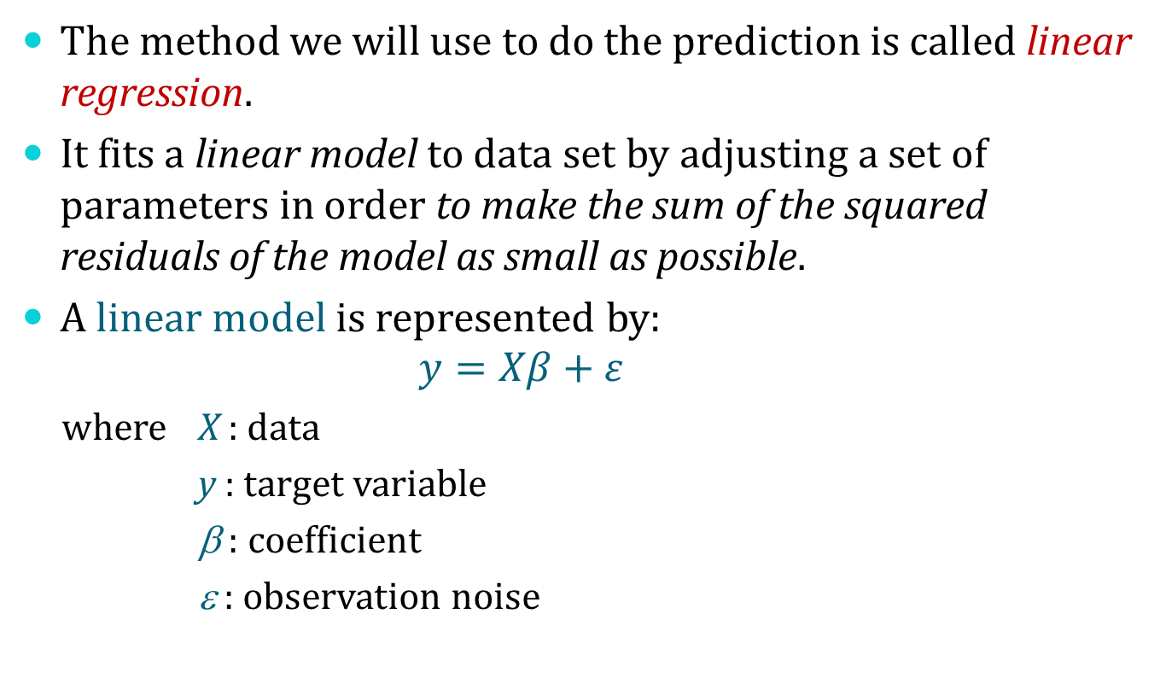
Regression with Linear Model (cont.)
The method we will use to do the prediction is called linear regression.
It fits a linear model to data set by adjusting a set of parameters in order to make the sum of the squared residuals of the model as small as possible.
A linear model is represented by:
$$y=Xβ+ε$$
where X : data
y : target variable
β : coefficient
ε : observation noise

Slide 22
Regression with Linear Model (cont.)
Now we use linear_model.LinearRegression() to do the prediction on the diabetes dataset:
>>> from sklearn import linear_model
>>> regr = linear_model.LinearRegression()
>>> regr.fit(diabetes_X_train, diabetes_y_train)
LinearRegression(copy_X=True, fit_intercept=True, n_jobs=1, normalize=False)
>>> print(regr.coef_)
[ 3.0350e-01 -2.3764e+02 5.1053e+02 3.2774e+02 -8.1413e+02
4.9281e+02 1.0285e+02 1.8461e+02 7.4352e+02 7.6095e+01]
>>> np.mean((regr.predict(diabetes_X_test)-diabetes_y_test)**2)
2004.5676026898223
>>> regr.score(diabetes_X_test, diabetes_y_test)
0.58507530226905713
Mean square error
1 – perfect prediction
0 – no linear relations

Slide 23
Unsupervised Learning
Clustering with K-means

Slide 24
Clustering with K-means
Unsupervised learning is a machine learning task that infers a function to describe hidden structure from unlabeled data.
There are two main approaches to unsupervised learning:
Clustering: To discover groups of similar examples within the data;
Density estimation: To determine the distribution of data within the input space.
Recalling the iris dataset, if we knew that there were 3 types of iris, but did not have access to a taxonomist to label them.
We could try a clustering task: split the observations into well-separated group called clusters.

Slide 25
Clustering with K-means (cont.)
There exist a lot of different clustering criteria and associated algorithms.
The simplest clustering algorithm is K-means.
The KMeans algorithm clusters data by trying to separate samples in n groups of equal variance, minimizing a criterion known as the inertia or within-cluster sum-of-squares.
This algorithm requires the number k of clusters to be specified.

Slide 26
Clustering with K-means (cont.)
Now we apply KMeans on the iris dataset.
>>> from sklearn import cluster, datasets
>>> iris = datasets.load_iris()
>>> X_iris = iris.data
>>> y_iris = iris.target
>>> k_means = cluster.KMeans(n_clusters=3)
>>> k_means.fit(X_iris)
KMeans(copy_x=True, init='k-means++', max_iter=300, n_clusters=3, n_init=10, n_jobs=1, precompute_distances='auto', random_state=None, tol=0.0001, verbose=0)
>>> print(k_means.labels_[::10])
[1 1 1 1 1 0 0 0 0 0 2 2 2 2 2]
>>> print(y_iris[::10])
[0 0 0 0 0 1 1 1 1 1 2 2 2 2 2]
Clustering results
Original observations

Slide 27
Working with Text Data
Newsgroups Datasets
Extracting Features from Text Files
Training a Classifier
Building a Pipeline
Performance Evaluation

Slide 28
Newsgroups Datasets
In addition to supervised learning and unsupervised learning, we explore some of the main scikit-learn tools on a single practical task.
This task is to analyze a collection of text documents (newsgroups posts) on twenty different topics.
The source of this section can be found under the folder:
lec12/text_analytics/
This folder contains:
*.rst files – the source of the lesson document written with sphinx (a tool that makes it easy to create intelligent and beautiful documentation for Python projects).
data – folder to put the datasets used during the lesson.

Slide 29
Newsgroups Datasets (cont.)
First we load 20 newgroups dataset by running the script fetch_data.py under the folder:
lec12/text_analytics/data/languages/
In order to get faster execution times for this first example we will work on a partial dataset with only 4 categories out of the 20 available in the dataset:
>>> categories = ['alt.atheism', 'soc.religion.christian', 'comp.graphics', 'sci.med']
Now we load the list of files matching those categories as follows:
>>> from sklearn.datasets import fetch_20newsgroups
>>> twenty_train = fetch_20newsgroups(subset='train',
categories=categories, shuffle=True, random_state=42)

Slide 30
Newsgroups Datasets (cont.)
Let’s inspect some partial information of the loaded data:
>>> twenty_train.target_names
['alt.atheism', 'comp.graphics', 'sci.med', 'soc.religion.christian']
>>> len(twenty_train.data)
2257
>>> print("\n".join(twenty_train.data[0].split("\n")[:3]))
From: sd345@city.ac.uk (Michael Collier)
Subject: Converting images to HP LaserJet III?
Nntp-Posting-Host: hampton
>>> print(twenty_train.target_names[twenty_train.target[0]])
comp.graphics

Slide 31
Extracting Features from Text Files
In order to perform machine learning on text documents, we first need to turn the text content into numerical feature vectors.
A feature vector is an n-dimensional vector of numerical features that represent some object.
A feature, in machine learning, is an individual measurable property of a phenomenon being observed. For example, the occurrence frequency of words in text processing.
In our case, we need a feature vector to store the occurrence frequencies of words with dimensions of number of documents (or files) and number of distinct words.

Slide 32
Extracting Features from Text Files (cont.)
Text preprocessing, tokenizing and filtering of stopwords are included in a high level component that is able to build a dictionary of features and transform documents to feature vectors:
>>> from sklearn.feature_extraction.text import CountVectorizer
>>> count_vect = CountVectorizer()
>>> X_train_counts = count_vect.fit_transform(twenty_train.data)
>>> X_train_counts.shape
(2257, 35788)
Once fitted, the vectorizer has built a dictionary of feature indices:
>>> count_vect.vocabulary_.get(u'algorithm')
4690

Slide 33
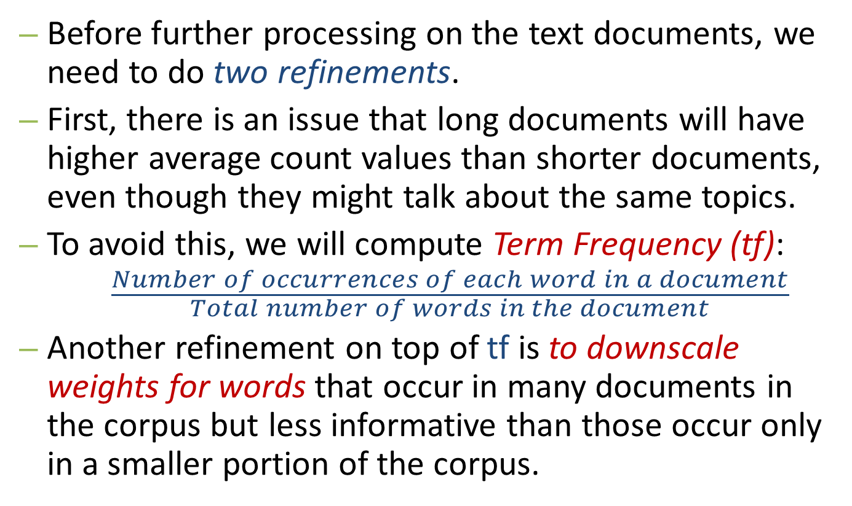
Extracting Features from Text Files (cont.)
Before further processing on the text documents, we need to do two refinements.
First, there is an issue that long documents will have higher average count values than shorter documents, even though they might talk about the same topics.
To avoid this, we will compute Term Frequency (tf):
$$\frac{Number of occurrences of each word in a document}{Total number of words in the document}$$
Another refinement on top of tf is to downscale weights for words that occur in many documents in the corpus but less informative than those occur only in a smaller portion of the corpus.

Slide 34
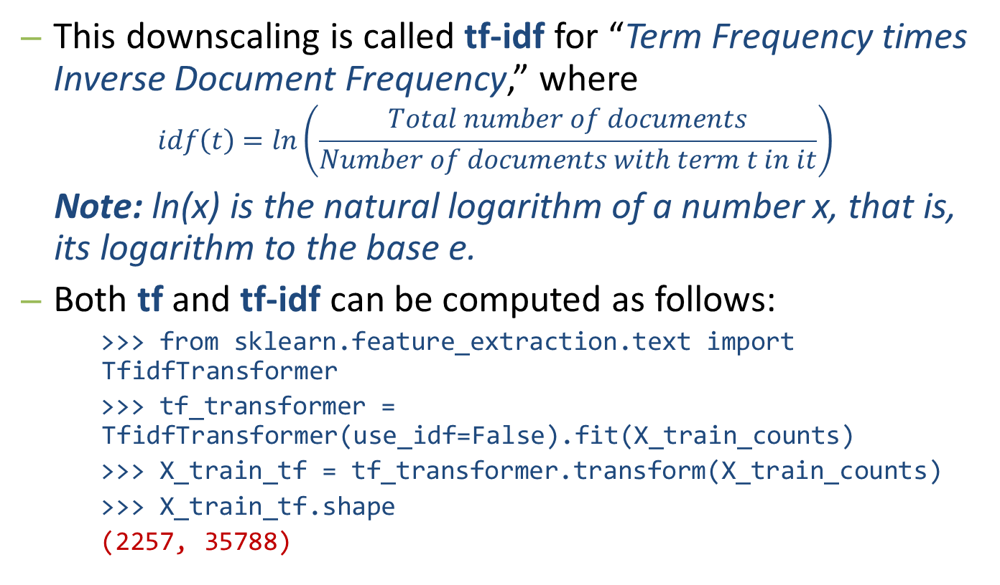
Extracting Features from Text Files (cont.)
This downscaling is called tf-idf for “Term Frequency times Inverse Document Frequency,” where
$$idf\left(t\right)=ln\left(\frac{Total number of documents}{Number of documents with term t in it}\right)$$
Note: ln(x) is the natural logarithm of a number x, that is, its logarithm to the base e.
Both tf and tf-idf can be computed as follows:
>>> from sklearn.feature_extraction.text import TfidfTransformer
>>> tf_transformer = TfidfTransformer(use_idf=False).fit(X_train_counts)
>>> X_train_tf = tf_transformer.transform(X_train_counts)
>>> X_train_tf.shape
(2257, 35788)
Notes:
Example of computing IDF:
Consider a document containing 100 words wherein the word cat appears 3 times. The term frequency (i.e., tf) for cat is then (3 / 100) = 0.03. Now, assume we have 10 million documents and the word cat appears in one thousand of these. Then, the inverse document frequency (i.e., idf) is calculated as log(10,000,000 / 1,000) = 4. Thus, the Tf-idf weight is the product of these quantities: 0.03 * 4 = 0.12.

Slide 35
Extracting Features from Text Files (cont.)
Now we combine the fit and transform operations into one as follows:
>>> tfidf_transformer = TfidfTransformer()
>>> X_train_tfidf = tfidf_transformer.fit_transform(X_train_counts)
>>> X_train_tfidf.shape
(2257, 35788)
Notes:
Example of computing IDF:
Consider a document containing 100 words wherein the word cat appears 3 times. The term frequency (i.e., tf) for cat is then (3 / 100) = 0.03. Now, assume we have 10 million documents and the word cat appears in one thousand of these. Then, the inverse document frequency (i.e., idf) is calculated as log(10,000,000 / 1,000) = 4. Thus, the Tf-idf weight is the product of these quantities: 0.03 * 4 = 0.12.

Slide 36
Training a Classifier
Now we have our features, we can train a classifier to try to predict the category of a post.
We start with a naïve Bayes classifier, which provides a nice baseline for this task.
Among the several variants of this classifier in scikit-learn, the most suitable for word counts is the multinomial variant:
>>> from sklearn.naive_bayes import MultinomialNB
>>> clf = MultinomialNB().fit(X_train_tfidf, twenty_train.target)

Slide 37
Training a Classifier (cont.)
To predict the outcome on a new document we need to extract the features using almost the same feature extracting chain as before:
>>> docs_new = ['God is love', 'OpenGL on the GPU is fast']
>>> X_new_counts = count_vect.transform(docs_new)
>>> X_new_tfidf = tfidf_transformer.transform(X_new_counts)
>>> predicted = clf.predict(X_new_tfidf)
>>> for doc, category in zip(docs_new, predicted):
print('%r => %s' % (doc, twenty_train.target_names[category]))
'God is love' => soc.religion.christian
'OpenGL on the GPU is fast' => comp.graphics

Slide 38
Building a Pipeline
In order to make the vectorizer → transformer → classifier easier to work with, scikit-learn provides a Pipeline class that behaves like a compound classifier:
>>> from sklearn.pipeline import Pipeline
>>> text_clf = Pipeline([('vect', CountVectorizer()),
('tfidf', TfidfTransformer()),
('clf', MultinomialNB()),
])
Now we can train the model with a single command:
>>> text_clf = text_clf.fit(twenty_train.data, twenty_train.target)

Slide 39
Performance Evaluation
Evaluating the predictive accuracy of the model is equally easy:
>>> import numpy as np
>>> twenty_test = fetch_20newsgroups(subset='test',
categories=categories, shuffle=True, random_state=42)
>>> docs_test = twenty_test.data
>>> predicted = text_clf.predict(docs_test)
>>> np.mean(predicted == twenty_test.target)
0.83488681757656458
Here we got 83.5% accuracy.
Next we will do better with a linear support vector machine (SVM), which is widely regards as one of the best text classification algorithms.

Slide 40
Performance Evaluation (cont.)
>>> from sklearn.linear_model import SGDClassifier
>>> text_clf = Pipeline([('vect', CountVectorizer()),
('tfidf', TfidfTransformer()),
('clf', SGDClassifier(loss='hinge', penalty='l2', alpha=1e-3, n_iter=5, random_state=42)),
])
>>> _ = text_clf.fit(twenty_train.data, twenty_train.target)
>>> predicted = text_clf.predict(docs_test)
>>> np.mean(predicted == twenty_test.target)
0.9127829560585885
scikit-learn further provides utilities for more detailed performance analysis of the results.

Slide 41
Performance Evaluation (cont.)
>>> from sklearn import metrics
>>> print(metrics.classification_report(twenty_test.target, predicted, target_names=twenty_test.target_names))
precision recall f1-score support
alt.atheism 0.95 0.81 0.87 319
comp.graphics 0.88 0.97 0.92 389
sci.med 0.94 0.90 0.92 396
soc.religion.christian 0.90 0.95 0.93 398
avg / total 0.92 0.91 0.91 1502

Slide 42
Self Study Guide

Slide 43
Self Study Guide:
Reference
Ivan Idris (2014). Python Data Analysis, Packt Publishing. (Read Ch. 10)
Joel Grus (2015). Data Science from Scratch, O’Reilly. (Read Ch. 11)
Andreas C. Müller and Sarah Guido (2016). Introduction to Machine Learning with Python (Early Release), O’Reilly.
Online Resources:
http://scikit-learn.org/stable/
https://www.coursera.org/learn/machine-learning
https://work.caltech.edu/telecourse.html
http://statweb.stanford.edu/~tibs/ElemStatLearn/

